Slide 1
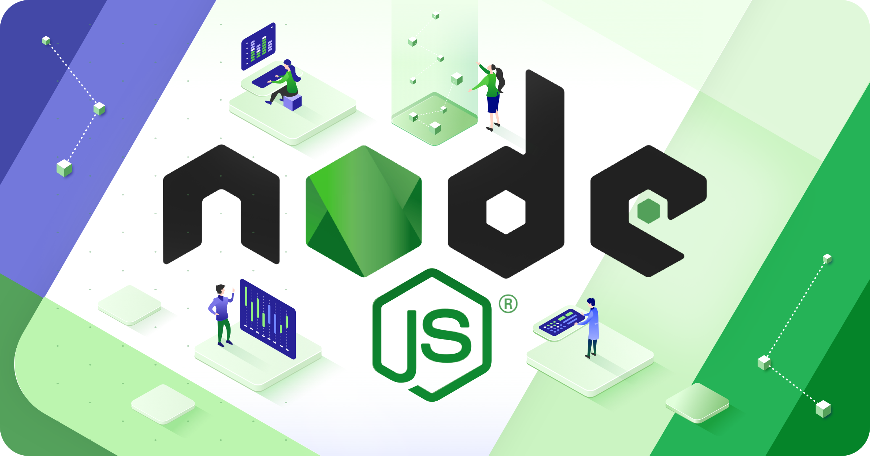

Slide 2
Introduction to Node.js :
Node.js is an open-source and cross-platform JavaScript runtime environment.
It is a popular tool for almost any kind of project.
Node.js runs the V8 JavaScript engine, the core of Google Chrome, outside of the browser.
A Node.js app runs in a single process, without creating a new thread for every request.
Node.js provides a set of asynchronous I/O primitives in its standard library that prevent JavaScript code from blocking.

Slide 3
libraries in Node.js are written using non-blocking paradigms, making blocking behavior the exception rather than the norm.
When Node.js performs an I/O operation, like reading from the network, accessing a database or the filesystem, instead of blocking the thread and wasting CPU cycles waiting, Node.js will resume the operations when the response comes back.
This allows Node.js to handle thousands of concurrent connections with a single server without introducing the burden of managing thread concurrency, which could be a significant source of bugs.
Node.js has a unique advantage because millions of frontend developers that write JavaScript for the browser are now able to write the server-side code in addition to the client-side code without the need to learn a completely different language.
In Node.js the new ECMAScript standards can be used without problems, as you don't have to wait for all your users to update their browsers.

Slide 4
How to Install Node.js and NPM on Windows? :
Prerequisites :
Here’s what you need to go ahead with NodeJs and NPM.
Hardware Requirements :
RAM 4GB
CPU Intel Core i3TM i3 HQ CPU @2.50 GHz
ROM 256 GB
Software Requirement :
Chocolatey

Slide 5
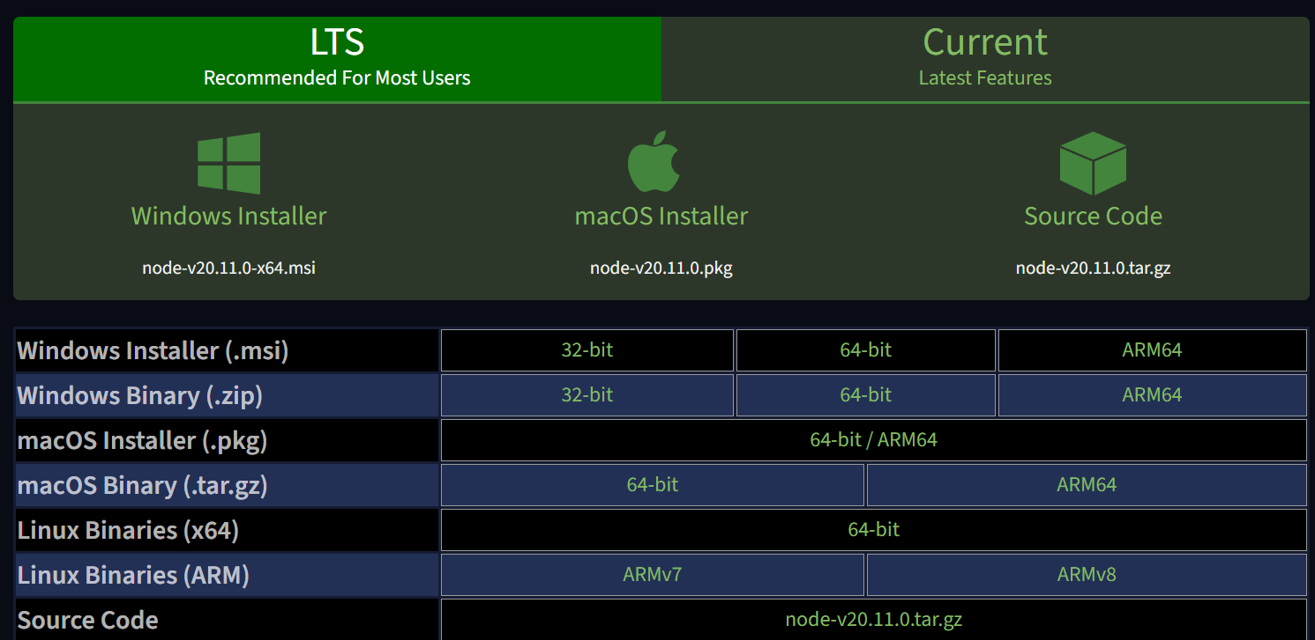
Here, we are going to explain the installation process step-by-step. So, let’s start with the first step now.
Step 1: Download the Installer :
Download the Windows Installer from NodeJs official website. Make sure you have downloaded the latest version of NodeJs. It includes the NPM package manager.
Here, we are choosing the 64-bit version of the Node.js installer.

Slide 6
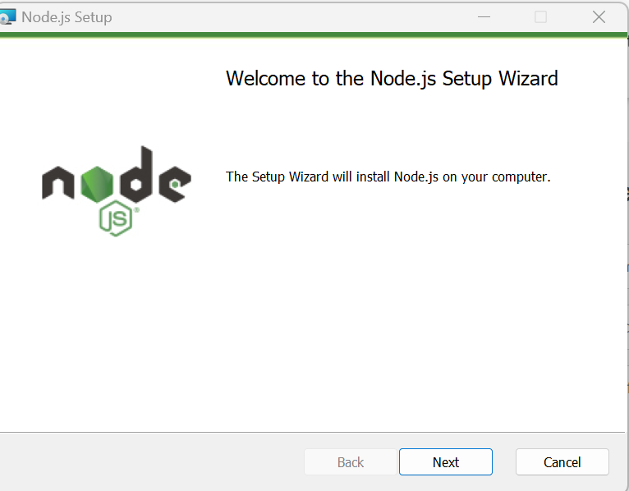
The LTS (Long-term Support) version is highly recommended for you. After the download of the installer package, install it with a double-click on it.
Now .msi file will be downloaded to your browser. Choose the desired location for that.
Step 2: Install Node.js and NPM

Slide 7
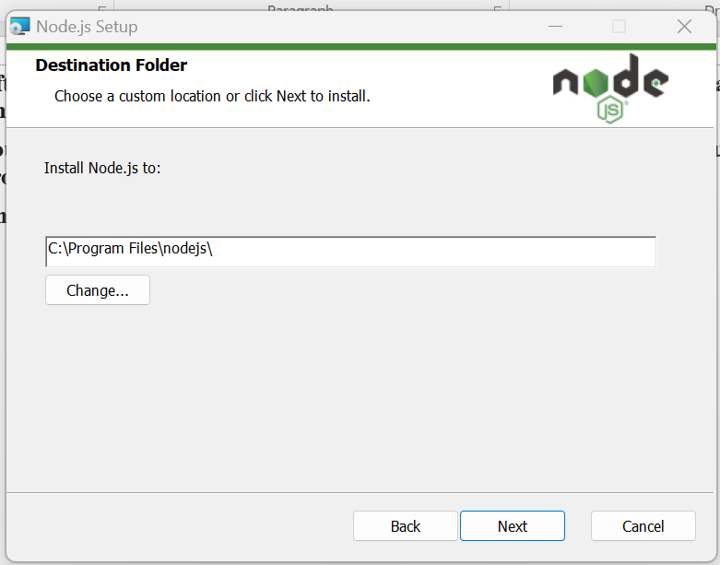
After choosing the path, double-click to install .msi binary files to initiate the installation process. Then give access to run the application.
You will get a welcome message on your screen and click the “Next” button. The installation process will start.
Choose the desired path where you want to install Node.js.

Slide 8
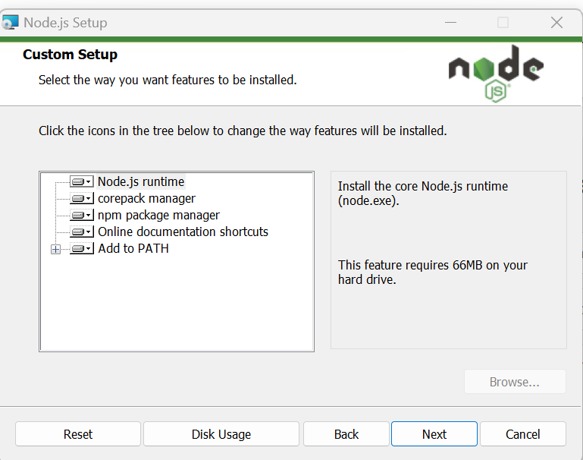
By clicking on the Next button, you will get a custom page setup on the screen. Make sure you choose npm package manager , not the default of Node.js runtime . This way, we can install Node and NPM simultaneously.
You should have 143MB of space to install Node.js and npm features.
he following features will be installed by default:
Node.js runtime
Npm package manager
Online documentation shortcuts
Add to Path
Bang! The setup is ready to install Node and NPM. Let’s click on the Install button so hard!

Slide 9
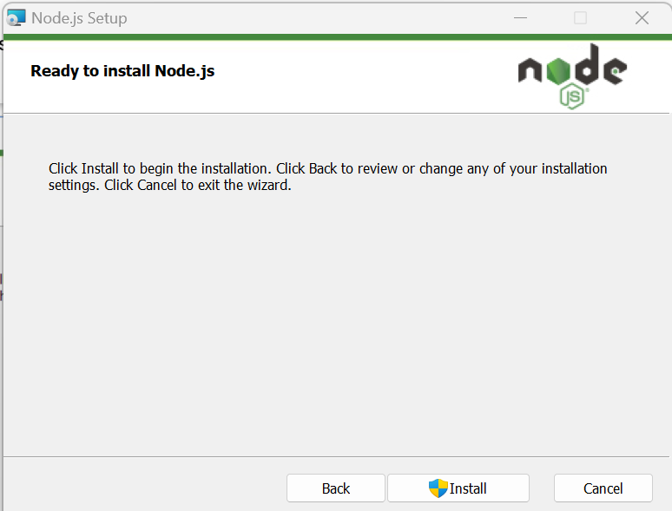
Click on the Install
Step 3: Check Node.js and NPM Version
If you have a doubt whether you have installed everything correctly or not, let’s verify it with “Command Prompt”.
node -v

Slide 10
Introduction to Node Modules :
Node modules provide a way to re-use code in your Node application. In some ways, they're similar to a class in other languages, like C# or Java.
In many ways, they're completely different from a class. If you've written a Node application, you've used modules, you just may not have known it.
At its core, a module is a piece of re-usable code with a defined interface. You bring a module into scope using require() like this:
const path = require('path');
console.info(path.extname('index.js'));
This code example loads the core module path and places a reference to it in the variable path. Using the const keyword for the variable declaration prevents it from being overwritten in the calling code. Bringing the path module into scope allows use of its functionality by calling the extname method on the path constant.

Slide 11
Modules are of three types:
Core Modules
local Modules
Third-party Modules
Core Modules: Node.js has many built-in modules that are part of the platform and come with Node.js installation. These modules can be loaded into the program by using the required function.
Syntax:
const module = require('module_name');
The require() function will return a JavaScript type depending on what the particular module returns. The following example demonstrates how to use the Node.js http module to create a web server.
const http = require('http');
http.createServer(function (req, res) {
res.writeHead(200, { 'Content-Type': 'text/html' });
res.write('Welcome to this page!');
res.end();
}).listen(3000);

Slide 12
Core Modules Description
http creates an HTTP server in Node.js.
assert set of assertion functions useful for testing.
fs used to handle file system.
path includes methods to deal with file paths.
process provides information and control about the current Node.js process.
os provides information about the operating system.
querystring utility used for parsing and formatting URL query strings.
url module provides utilities for URL resolution and parsing.
Local Modules: Unlike built-in and external modules, local modules are created locally in your Node.js application. Let’s create a simple calculating module that calculates various operations. Create a calc.js file that has the following code:

Slide 13
exports.add = function (x, y) {
return x + y;
};
exports.sub = function (x, y) {
return x - y;
};
exports.mult = function (x, y) {
return x * y;
};
exports.div = function (x, y) {
return x / y;
};
Since this file provides attributes to the outer world via exports, another file can use its exported functionality using the require() function

Slide 14
Filename: index.js
const calculator = require('./calc');
let x = 50, y = 10;
console.log("Addition of 50 and 10 is "
+ calculator.add(x, y));
console.log("Subtraction of 50 and 10 is "
+ calculator.sub(x, y));
console.log("Multiplication of 50 and 10 is "
+ calculator.mult(x, y));
console.log("Division of 50 and 10 is "
+ calculator.div(x, y));
Step to run this program: Run the index.js file using the following command:
node index.js

Slide 15
Third-party modules: Third-party modules are modules that are available online using the Node Package Manager(NPM). These modules can be installed in the project folder or globally. Some of the popular third-party modules are Mongoose, express, angular, and React.
Example:
npm install express
npm install mongoose
npm install -g @angular/cli

Slide 16
Path Modules :
Node.js Path Modules:
The node:path module provides utilities for working with file and directory paths. It can be accessed using:
const path = require('node:path');
Windows vs. POSIX
The default operation of the node:path module varies based on the operating system on which a Node.js application is running. Specifically, when running on a Windows operating system, the node:path module will assume that Windows-style paths are being used.
So using path.basename() might yield different results on POSIX and Windows:
path.basename('C:\\temp\\myfile.html');
// Returns: 'C:\\temp\\myfile.html‘
Reference Link : https://nodejs.org/api/path.html

Slide 17
Node.js path.basename() Method | This is used to get the filename portion of a path to the file.
Node.js path.dirname() Method | This is used to get the directory name of the given path.
Node.js path.extname() Method | This is used to get the extension portion of a file path.
Node.js path.format() Method | This is used to return a path string from the given path object.
Node.js path.isAbsolute() Method | This is used to check whether the given path is an absolute path or not.
Node.js path.join() Method | This is used to join a number of path segments using the platform-specific delimiter to form a single path.
Node.js path.normalize() Method | This is used to normalize the given path.
Node.js path.parse() Method | This s used to return an object whose properties represent the given path.
Node.js path.relative() Method | This is used to find the relative path from a given path to another path based on the current working directory.
Node.js path.resolve() Method | This is used to resolve a sequence of path segments to an absolute path.
Node.js path.toNamespacedPath() Method | This is used to find the equivalent namespace-prefixed path from the given path.

Slide 18
FS Module and Files:
The Node.js file system module allows you to work with the file system on your computer.
Node.js is a JavaScript runtime built on Chrome’s V8 JavaScript engine. Node.js helps developers to write JavaScript code to run on the server-side, to generate dynamic content and deliver to the web clients. The two features that make Node.js stand-out are:
Event-driven
Non-blocking I/O model
To include the File System module, use the require() method:
var fs = require('fs');
Common use for the File System module:
Read files
Create files
Update files
Delete files
Rename files

Slide 19
Synchronous approach: They are called blocking functions as it waits for each operation to complete, only after that, it executes the next operation, hence blocking the next command from execution i.e. a command will not be executed until & unless the query has finished executing to get all the result from previous commands.
Asynchronous approach: They are called non-blocking functions as it never waits for each operation to complete, rather it executes all operations in the first go itself. The result of each operation will be handled once the result is available i.e. each command will be executed soon after the execution of the previous command. While the previous command runs in the background and loads the result once it is finished processing the data.
Use cases:
If your operations are not doing very heavy lifting like querying huge data from DB then go ahead with Synchronous way otherwise Asynchronous way.
In an Asynchronous way, you can show some progress indicator to the user while in the background you can continue with your heavyweight works. This is an ideal scenario for GUI based apps.
Example of asynchronous and synchronous: Create a text file named input.txt with the following content:
Create file with input.txt : DevOps Training
Now let us create a js file named main.js with the following code:

Slide 20
var fs = require("fs");
// Asynchronous read
fs.readFile('input.txt', function (err, data) {
if (err) {
return console.error(err);
}
console.log("Asynchronous read: " + data.toString());
});
Output:
Asynchronous read:DevOps Training

Slide 21
var fs = require("fs");
// Synchronous read
var data = fs.readFileSync('input.txt');
console.log("Synchronous read: " + data.toString());
Output:
Synchronous read: DevOps Training
Open a File: The fs.open() method is used to create, read, or write a file. The fs.readFile() method is only for reading the file and fs.writeFile() method is only for writing to the file, whereas fs.open() method does several operations on a file. First, we need to load the fs class which is a module to access the physical file system.
Syntax:
fs.open(path, flags, mode, callback)

Slide 22
Parameters:
path: It holds the name of the file to read or the entire path if stored at other locations.
flags: Flags indicate the behavior of the file to be opened. All possible values are ( r, r+, rs, rs+, w, wx, w+, wx+, a, ax, a+, ax+).
mode: Sets the mode of file i.e. r-read, w-write, r+ -readwrite. It sets to default as readwrite.
err: If any error occurs.
data: Contents of the file. It is called after the open operation is executed.
Example: Let us create a js file named main.js having the following code to open a file input.txt for reading and writing.
var fs = require("fs");
// Asynchronous - Opening File
console.log("opening file!");
fs.open('input.txt', 'r+', function(err, fd) {
if (err) {
return console.error(err);
}
console.log("File open successfully");
});
Output:
opening file!
File open successfully

Slide 23
Reading a File: The fs.read() method is used to read the file specified by fd. This method reads the entire file into the buffer.
fs.read(fd, buffer, offset, length, position, callback)
Parameters:
fd: This is the file descriptor returned by fs.open() method.
buffer: This is the buffer that the data will be written to.
offset: This is the offset in the buffer to start writing at.
length: This is an integer specifying the number of bytes to read.
position: This is an integer specifying where to begin reading from in the file. If the position is null, data will be read from the current file position.
callback: It is a callback function that is called after reading of the file. It takes two parameters:
err: If any error occurs.
data: Contents of the file
Example: Let us create a js file named main.js having the following code:

Slide 24
var fs = require("fs");
var buf = new Buffer(1024);
console.log("opening an existing file");
fs.open('input.txt', 'r+', function(err, fd) {
if (err) {
return console.error(err);
}
console.log("File opened successfully!");
console.log("reading the file");
fs.read(fd, buf, 0, buf.length, 0, function(err, bytes){
if (err){
console.log(err);
}
console.log(bytes + " bytes read");
// Print only read bytes to avoid junk.
if(bytes > 0){
console.log(buf.slice(0, bytes).toString());
}
});
});

Slide 25
Writing to a File: This method will overwrite the file if the file already exists. The fs.writeFile() method is used to asynchronously write the specified data to a file. By default, the file would be replaced if it exists. The ‘options’ parameter can be used to modify the functionality of the method.
Syntax:
fs.writeFile(path, data, options, callback)
Parameters:
path: It is a string, Buffer, URL, or file description integer that denotes the path of the file where it has to be written. Using a file descriptor will make it behave similarly to fs.write() method.
data: It is a string, Buffer, TypedArray, or DataView that will be written to the file.
options: It is a string or object that can be used to specify optional parameters that will affect the output. It has three optional parameters:
encoding: It is a string value that specifies the encoding of the file. The default value is ‘utf8’.
mode: It is an integer value that specifies the file mode. The default value is 0o666.
flag: It is a string value that specifies the flag used while writing to the file. The default value is ‘w’.
callback: It is the function that would be called when the method is executed.
err: It is an error that would be thrown if the operation fails.
Example: Let us create a js file named main.js having the following code:

Slide 26
var fs = require("fs");
console.log("writing into existing file");
fs.writeFile('input.txt', 'Geeks For Geeks', function(err) {
if (err) {
return console.error(err);
}
console.log("Data written successfully!");
console.log("Let's read newly written data");
fs.readFile('input.txt', function (err, data) {
if (err) {
return console.error(err);
}
console.log("Asynchronous read: " + data.toString());
});
});

Slide 27
Appending to a File: The fs.appendFile() method is used to synchronously append the data to the file.
Syntax:
fs.appendFile(filepath, data, options, callback);
OR
fs.appendFileSync(filepath, data, options);
Parameters:
filepath: It is a String that specifies the file path.
data: It is mandatory and it contains the data that you append to the file.
options: It is an optional parameter that specifies the encoding/mode/flag.
Callback: Function is mandatory and is called when appending data to file is completed.
Example 1: Let us create a js file named main.js having the following code:

Slide 28
var fs = require('fs');
var data = "\nLearn Node.js";
// Append data to file
fs.appendFile('input.txt', data, 'utf8',
// Callback function
function(err) {
if (err) throw err;
// If no error
console.log("Data is appended to file successfully.")
});

Slide 29
Example 1: For synchronously appending
var fs = require('fs');
var data = "\nLearn Node.js";
// Append data to file
fs.appendFileSync('input.txt', data, 'utf8');
console.log("Data is appended to file successfully.")

Slide 30
There are different ways to handle operations in Node or JavaScript. For asynchronous execution, different processes run simultaneously and are handled once the result of each process is available. There are different ways to handle the asynchronous code in Node or in JavaScript which are:
Promises
Async/Await
Difference Between Promise and Async/Await
1. Promises:
In Node, a Promise is akin to a real-life commitment, ensuring the execution of an asynchronous event and managing its aftermath through three states: pending, resolved, or rejected.
Pending: Initial State, before the event has happened.
Resolved: After the operation completed successfully.
Rejected: If the operation had error during execution, the promise fails.
Error Handling of Promises: To handle a resolved promise, use the .then() method, and for a rejected promise, use .catch(). To execute code after promise handling, use .finally(), ensuring the code within runs regardless of the promise state.

Slide 31
Example: During database server data retrieval, a Promise remains pending until successful data reception (resolved state) or unsuccessful retrieval (rejected state).
const promise = new Promise(function (resolve, reject) {
const string1 = “devopstraining";
const string2 = “devopstraining";
if (string1 === string2) {
resolve();
} else {
reject();
}
});
promise
.then(function () {
console.log("Promise resolved successfully");
})
.catch(function () {
console.log("Promise is rejected");
});

Slide 32
2. Async/Await:
Async/Await simplifies working with promises, offering a cleaner syntax in asynchronous functions. The ‘await’ keyword, exclusive to async functions, pauses execution until the awaited promise resolves or rejects.
Error Handling in Async/Await: For a successfully resolved promise, we use try and for rejected promise, we use catch. To run a code after the promise has been handled using try or catch, we can .finally() method. The code inside .finally() method runs once regardless of the state of the promise.
const helperPromise = function () {
const promise = new Promise(function (resolve, reject) {
const x = "geeksforgeeks";
const y = "geeksforgeeks";
if (x === y) {
resolve("Strings are same");
} else {
reject("Strings are not same");
}
});
return promise;
};

Slide 33
async function demoPromise() {
try {
let message = await helperPromise();
console.log(message);
} catch (error) {
console.log("Error: " + error);
}
}
demoPromise();

Slide 34


